Slide 1

COLLEGE MANAGEMENT SYSTEM
PANCHANAN TURUK(15/04/DCS/04)

Slide 2
OBJECTIVE
Introduction the features of college management system
Managing all the user information
Introduce the feature of login and register
Finding all the information about admission more easily
Improve the quality of the project
Making the website more secured.

Slide 3
About Project
School/college/university Management Module which is used by Schools as well as Colleges to manage their daily activities which include the management of Employees, Students, Books and Library Records, Assignments, Admission Process, Results and Reports, Exams, Events, Attendance, Timetable, Fees and Other Reports. It provides one-point access to manage these wide range of activities both effectively and efficiently.
The system will be used by four people, which are Admin, Teacher, Librarian and Student.
Admin can login using valid credentials and perform various task such as Adding a Teacher, Librarian and events and also can view them.
System allows admin to view book request received from librarian.

Slide 4
Modules:
Admin:
Login: Admin can login his personal account.
Add/View Teacher: Admin add Teacher detail into a system
Add/View Librarian: Admin add librarian detail into a system
Add Event: Admin add event detail into a system.
View/Delete Book Request: Admin can view and delete book request from database.
View Books: Admin can see all the books detail from database.

Slide 5
2. Teacher:
Login: Teacher can login in his personal account.
Add Assignment: Teacher can add assignment detail for the students.
Add Attendance: Teacher can add attendance detail into a database.
Add Result: Teacher can add result detail.
Add Time-Table: Teacher set and add time table.
View Event: Teacher can view event detail from database.

Slide 6
3. Librarian:
Login: Librarian can login in his/her personal account.
Add Books: Librarian can add books into database for student use.
Request a Book: View student request for a book.
Issue a Book: View detail of all issue books.
Return a Book: view detail of all return book.
View Event: Librarian can view all the events.

Slide 7
4. Student:
Login: Student can login his/her personal account.
View Profile: Student can see his profile.
View Books: Student can view book added by librarian.
View Time-Table: Student can view all timetable detail.
Attendance: Student can view attendance added by faculty.
Result: Student can see his Result.

Slide 8
EXISTING SYSTEM
Students can not see their profile and detailed info.
Students can not view their timetables, assignments, attendance etc.
Student, Faculty, Librarian Login are not provided
Provide less information.
Not Faster.
Admin panel is not provided.
Not Secure (Existing user can view activity and data).

Slide 9
PROPOSED SYSTEM
This system is very easy to understand and user friendly.
This website helps the users to view their profile and detailed info.
Teacher, Student, Librarian are connected with each other on one system.
This website provides online admission procedure.
This system is saving the time for student and teacher too.
In this system user can connect any time whenever he/she wants.
This system is secure.
This System retrieves data faster.

Slide 10
SYSTEM SPECIFICATIONS
1. Minimum Hardware Requirements
CPU : Dual Core
Speed : 1 GHz
Coprocessor : BUILT IN
Total RAM : 512 MB
Hard Disk : 50 GB
Display : SGVA COLOR
2. Software Requirements
FRONT END : HTML, CSS, JAVASCRIPT, PHP
BACK END : MySQL
SERVER : APACHE SERVER
OPERATING SYSTEM : WINDOWS 7/8/8.1/10

Slide 11
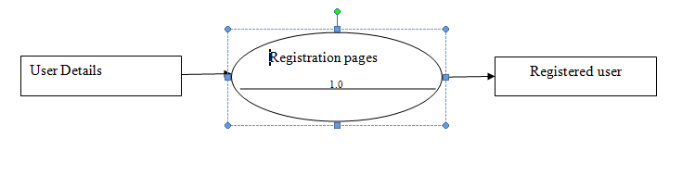
CONTEXT DIAGRAM

Slide 12
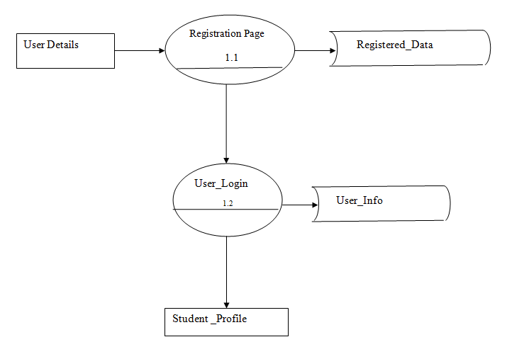
DATA FLOW DIAGRAM

Slide 13
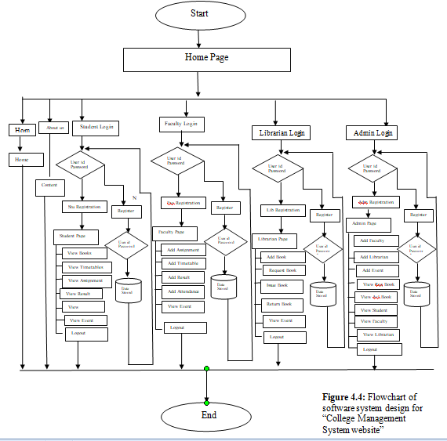
FLOWCHART

Slide 14
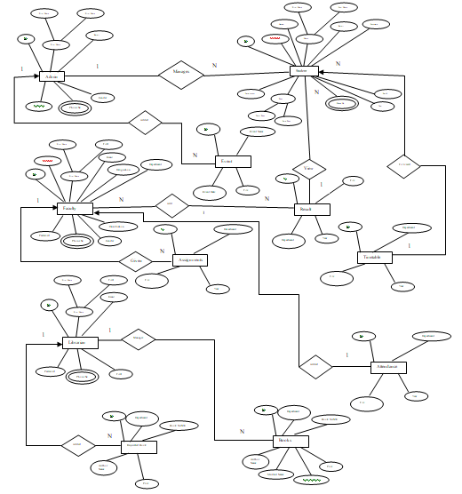
ER DIAGRAM

Slide 15

HOME PAGE

Slide 16
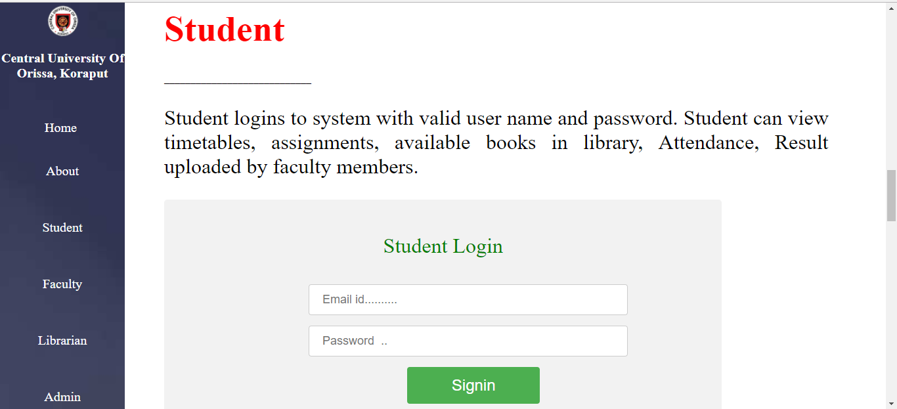
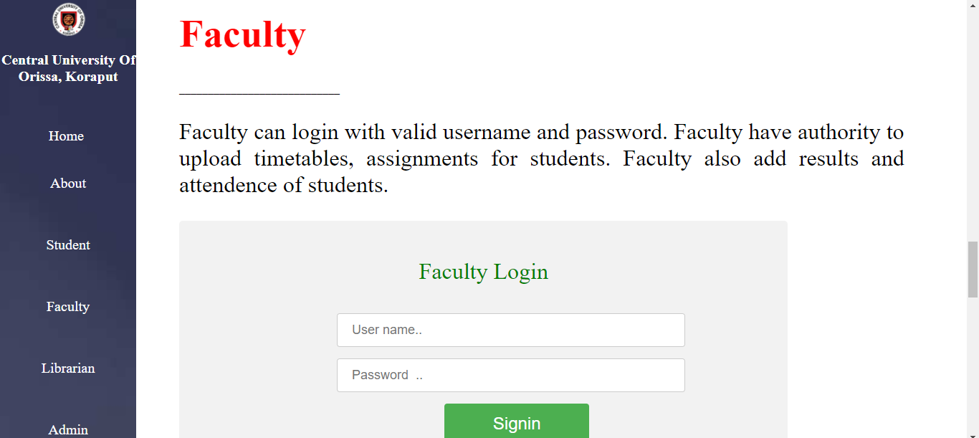
LOGIN PAGE

Slide 17
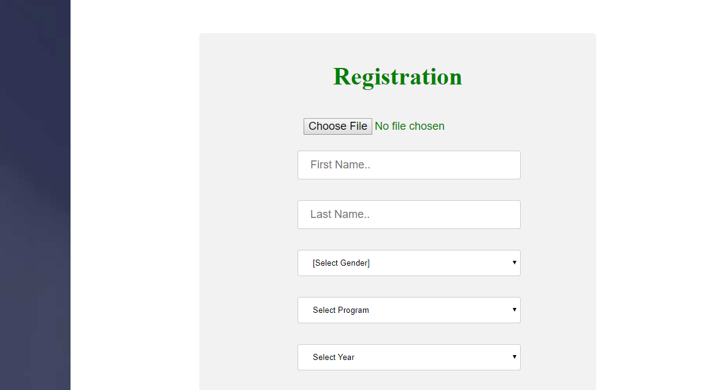
REGISTRATION FORM

Slide 18
CONCLUSION
The College Management System is completed, satisfying the required design specification.
The system provides a user-friendly interface.
All modules in the project have been tested the project have been tested the project have been tested with valid data and invalid data and everything works successfully.
The constraints are met and overcome successfully.

Slide 19
REFRENCES
Nevon Projects
W3School
JavaTpoin
PhpTpoint
TutorialPoint
Wikipedia
Web Technology Black Book
PHP The Complte Reference
Tutorial Point
Stack Overflow
Central University for Orissa

